Slide 1
Into the lab
DO NOW · 5 MIN
Friday 18 September 2026
1
What is a hypothesis?
2
What does a scientific theory do?
A prediction about an observation.
It explains why something happens.
3
4
Temperature vs how fast sugar dissolves: which is the independent variable?
Name a ‘forgotten’ scientist.
Anning · Johnson · Bell Burnell, etc.
Temperature; it’s the one you change.
5
Why do scientists repeat measurements?
6
What does a Bunsen burner produce?
To get more accurate results.
Fire!
Notes:
DO NOW — 5 minutes. Four clicks, one answer each.
BEFORE THE BELL, and this one is not optional: CHECK YOUR CLASS LIST FOR LATEX ALLERGY. Balloons are latex. A student with a latex allergy must not handle one, and in a severe case should not be in the room while they are being blown up. Nitrile or mylar balloons are the substitute if you need one.
ALSO BEFORE THE BELL: goggles counted out, heat-proof mats down, a bin by each bench for balloon fragments, and a jug of water per bench.
Q1 to Q3 are the last three lessons. Fast.
Q4 IS A TEMPERATURE CHECK, not a test. Some will have used one at primary school, most will not. Collect three answers and find out what you are dealing with.
THE DATE ON THIS SLIDE is a placeholder — change it before you teach.

Slide 2



TODAY · 2 MIN
Today
Say what physical science is.
Use a Bunsen burner safely.
Make a balloon that will not burst.
Last lesson of this unit. Time for a practical!
Notes:
TODAY — 2 minutes. Four clicks.
Read each goal, do not elaborate. Goal 3 is the one they will react to; let them.
SAY: "Three lessons of talking about science. Today you do some."
DO NOT PROMISE THE BALLOON WORKS. Say you will find out together. If a student has seen it before, ask them to keep it to themselves.

Slide 3

PREDICT · 3 MIN
Two balloons. One flame.
Which one bursts over a flame?
A
Both burst.
BALLOON 1
BALLOON 2
Just air.
A little water inside, then air.
B
Only balloon 1 bursts.
C
Only balloon 2 bursts.
Write your prediction in your book. You are about to test it yourself!
Notes:
PREDICT — 3 minutes. Four clicks: each balloon, the question, the options.
HANDS UP FOR EACH and write the tally on the board. Most classes pick A, because a balloon near a flame bursting is the most obvious thing in the world.
THEY MUST WRITE THE PREDICTION DOWN before they touch anything. A prediction you did not record is a prediction you can pretend you never made, and half the value of the practical is being wrong in writing.
DO NOT HINT. If someone knows the trick, thank them and ask them to stay quiet.
THE ANSWER IS B, and they find it out themselves on slide 8.

Slide 4


I DO · 4 MIN
Physical science
The study of matter and energy.
MATTER + ENERGY
CHEMISTRY
PHYSICS
What things are made of, and how they change into other things.
How energy behaves, and how it moves things about.
Notes:
I DO — 4 minutes. Four clicks: the banner, each half, the closing line.
KEEP IT SHORT. Matter is stuff. Energy is what makes stuff do things. Chemistry is mostly the first, physics is mostly the second, and the line between them is blurry on purpose.
THE CLOSING LINE MATTERS: burning gas is a chemical change, and heat moving from a flame into water is physics. One balloon, both subjects. Say it now and come back to it on slide 9.
MISCONCEPTION: "physics and chemistry are completely different subjects." They are the same subject with two doors into it. Biology mostly sits on top of both.
DO NOT list branches of science. They do not need taxonomy, they need to get to the Bunsen burners.

Slide 5
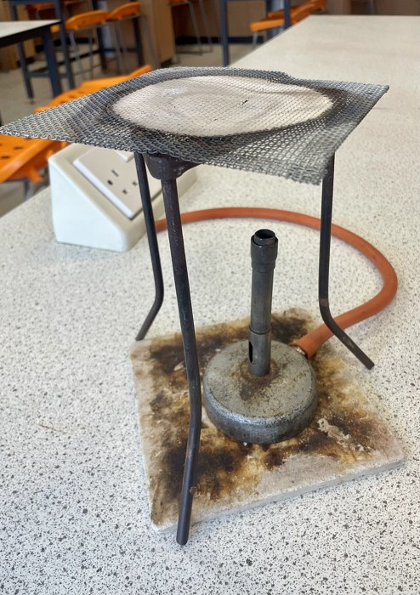
EQUIPMENT · 4 MIN
Meet the Bunsen burner
Barrel
The metal tube the flame comes out of. It gets very hot and stays hot.
Air hole
The slot near the bottom. Open it for a hot blue flame, close it for a safety flame.
Gas tap
On the bench. Off means off — check it before you light anything.
Heat-proof mat
Always underneath. The bench is not heat-proof and you are not paying for it.
Photo: Zax71, CC0, Wikimedia Commons.
Notes:
EQUIPMENT — 4 minutes. Four clicks, one part each.
HOLD A REAL ONE UP while you do this. The photograph is for the ones at the back.
SAFETY BRIEF STARTS HERE and continues on the next two slides. Do not let anyone touch a burner until slide 7 is done.
THE BARREL STAYS HOT for a long time after the flame is out and it does not look hot. That is the injury that actually happens in Year 7. Say it twice.
CHECK THE GAS TAPS ARE OFF before you hand anything out. Walk the room and look.
IF YOUR BENCHES HAVE A MASTER GAS VALVE, show them where it is and tell them you can cut the gas to the whole room in one second. It is reassuring and it is true.

Slide 6
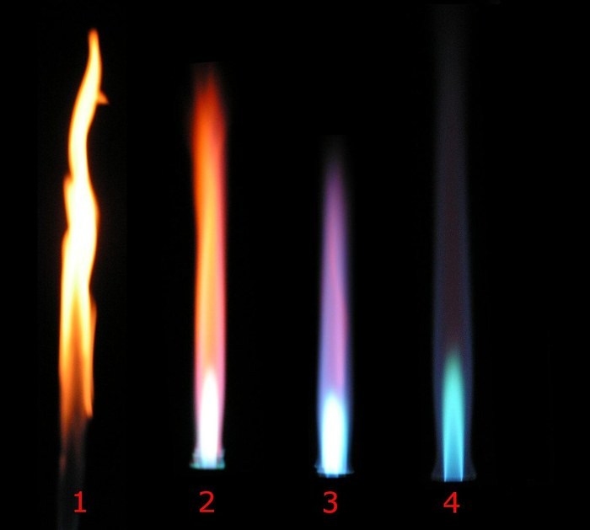
EQUIPMENT · 3 MIN
Two flames that matter
1
1
SAFETY FLAME
Orange, wavy, easy to see. Air hole CLOSED. Make sure the safety flame is on first!
3
3
BLUE FLAME
Roaring, blue, much hotter, and hard to see in a bright room. Air hole open.
Air hole closed → open, left to right
Photo: Arthur Jan Fijałkowski, CC BY-SA 3.0, Wikimedia Commons.
Notes:
EQUIPMENT — 3 minutes. Three clicks: the photo, then each flame.
THE RULE THEY MUST LEAVE WITH: not heating means safety flame. Every time you turn round, every burner in the room should be orange.
THE BLUE FLAME IS NEARLY INVISIBLE in a bright lab and that is exactly why it is dangerous. Ask them how you would know a burner was on if you could not see the flame. The answer is that you assume every burner is on.
DO NOT USE THE ROARING FLAME today. Flame 4 is more than this experiment needs and it makes the balloon burst faster than students can react.
THE PHOTOGRAPH shows four flames as the air hole opens. Only 1 and 3 matter today.

Slide 7




SAFETY · 4 MIN
Before anyone lights anything
Goggles on.
Stand up. Chairs in.
Balloon at arm’s length.
Safety flame when waiting.
Before the gas goes on. They stay on until every burner is out.
Bags under the bench. Long hair tied back.
Keep away from your faces.
Orange flame after you stop heating.
There will be loud, sudden sounds of popping balloons.
Notes:
SAFETY — 4 minutes. Five clicks. Do not rush this and do not read it flatly.
LATEX ALLERGY. Checked before the lesson, and if anyone is affected they do not handle balloons. Say nothing that identifies them.
THE BANG IS LOUD. Warn the class properly before the first burst, and check whether anyone is noise-sensitive — ear defenders or a step into the corridor for the first one is a reasonable adjustment and costs nothing. A student who is startled and flinches backwards into a lit burner is the realistic accident here, which is why the banner is on the slide.
HOLDING THE BALLOON: by the neck, arm extended, balloon at least 10 cm above the top of the barrel. Never lean over it. Tongs are an option if a student is nervous.
HAVE READY: heat-proof mats, a bin per bench for latex fragments, a jug of water per bench, goggles for all.
ASK THEM TO SAY THE FOUR RULES BACK before you release them. Thirty seconds, and it is the difference between a good practical and a bad one.

Slide 8
PRACTICAL · 16 MIN
The unbreakable balloon
1
Blow up balloon 1.
2
Light the Bunsen. Blue flame.
3
Hold balloon 1 above the flame.
Just air. Tie it or pinch the mouth so no air escapes.
Safety first, then open the air hole.
Arm out. 10 cm above the flame. Count out loud. Write down how long it took to burst in your book.
4
Put water in balloon 2.
5
Hold balloon 2 above the flame.
6
Record. Then swap roles.
About half a cup. Then blow it up over the water and tie it.
Water at the bottom, flame under the water. Count again.
Every group gets a turn. Write down what you saw.
Goggles on. Stools in. Safety flame whenever you stop.
Notes:
PRACTICAL — 16 minutes. Six clicks, then leave the slide up the whole time.
DEMONSTRATE BALLOON 1 YOURSELF FIRST, at the front, with the class back. One bang, everyone has heard it, and the startle is out of the way before anyone is holding anything.
THEN DEMONSTRATE BALLOON 2. Do not explain it. Let them see it not burst and let the room react.
THEN RELEASE THEM in pairs or threes. Roughly 10 minutes of hands-on is plenty.
BALLOON SIZE MATTERS. Overfilled balloons burst faster and louder. Grapefruit, not football.
WATER: about half a cup, 50 to 100 ml. Too little and the rubber above the waterline still fails; too much and it is awkward to hold.
THE FLAME MUST BE UNDER THE WATER, not under the air above it. This is the commonest reason a group's second balloon bursts, and it is a good thing to let them discover and correct.
THE BALLOON GOES BLACK. That is soot from the flame, and it is worth pointing out — it is unburnt carbon, and it is chemistry happening in front of them.
CIRCULATE AND COUNT SECONDS OUT LOUD with groups. It turns a bang into a measurement.
FIVE MINUTES BEFORE THE END: gas off, burners cooling, goggles stay on until you say otherwise, fragments in the bin.

Slide 9

EXPLAIN · 4 MIN
So why did it not burst?
BALLOON 1
BALLOON 2
The rubber is very thin. The flame heats it in under a second, it gets weak, and the air pushing out does the rest.
The water soaks up the heat and carries it away from the rubber. The rubber never gets hot enough to fail.
Water takes a LOT of energy to warm up. More than almost anything else on Earth.
That is why the sea takes all summer to warm up, why a hot water bottle stays warm all night, and why your body is mostly water.
Notes:
EXPLAIN — 4 minutes. Five clicks: each panel, the key line, the banner.
ASK BEFORE YOU CLICK: "the water was touching the rubber. Why did that help?" Take three answers before revealing anything. Somebody usually gets close.
THE IDEA, in Year 7 language: the heat goes into the water instead of into the rubber. Water is very good at soaking up heat without getting much hotter itself.
DO NOT SAY "SPECIFIC HEAT CAPACITY" unless a student asks. If one does, give them the phrase and tell them they have just met a Year 10 idea two years early.
GET THEM TO TOUCH THE BALLOON afterwards — the water inside is barely warm. That is the evidence, and it is much better than being told.
CALL BACK TO SLIDE 4: burning gas is chemistry, heat moving into water is physics. One balloon, both halves of physical science.
GO BACK TO THE PREDICTION TALLY. Ask who changed their mind, and be pleased about it rather than teasing. Changing your mind because of evidence is the entire unit.

Slide 10






WHERE THIS GOES · 3 MIN
What this turns into
Every one of these starts with someone wondering why the balloon did not burst.
Materials engineer
Battery scientist
Fusion engineer
Designs stuff that survives what nothing else survives — like the heat shield on a spacecraft.
Works out how to store enough energy to run a city overnight.
Building a machine that holds a star. Genuinely. It is being built now.
Medical physicist
Climate scientist
Space engineer
Aims radiation precisely enough to destroy a tumour and nothing else.
Measures what the planet is doing and works out what happens next.
Gets things off this planet and brings them back in one piece.
Notes:
WHERE THIS GOES — 3 minutes. Six clicks.
THIS IS THE POINT OF THE LESSON, so do not let it become a list read out at speed. Click them, and say one real sentence about the two you personally find most exciting. Enthusiasm is the curriculum here.
FUSION IS THE ONE THAT LANDS. Machines are being built right now to hold plasma hotter than the centre of the Sun. The people who finish that job are in Year 7 somewhere.
MATERIALS ENGINEER IS THE CLOSEST TO TODAY. Choosing what something is made of so it survives heat is exactly the balloon question, scaled up.
DO NOT TALK ABOUT GRADES OR SUBJECT CHOICES. They are twelve. The message is "this is interesting and the door is open", not "work hard or else".
IF THERE IS TIME, ask which one they would pick. Take four answers and no commentary.

Slide 11
PLENARY · 2 MIN
Before you go
1
What is physical science the study of?
Matter and energy.
2
Which flame do you use when you are not heating?
The orange safety flame.
3
Why did the second balloon survive?
The water took the heat away from the rubber.
That is the unit. You know what science is, how it works, who did it—and now you have been a scientist!
Notes:
PLENARY — 2 minutes. Four clicks.
GAS OFF AND BURNERS COOL BEFORE THIS SLIDE. Goggles can come off once every burner is out and counted back in.
Q3 is the assessed one. Take two or three answers before clicking; you want "the water took the heat", not "the water protected it".
THE CLOSING LINE closes the unit. Say it and mean it.
COUNT THE GOGGLES BACK IN. Check every gas tap yourself before the room empties — do not delegate it.

